Slide 1
Python for data analysis
Online Shoppers Purchasing Intention
2020 - ESILV A5 Antoine THIOL - Klarissa TU

Slide 2
Introduction
The following analyzes were made on a shoppers purchasing intention dataset.
It is a project for the “Python for data analysis” course at ESILV for the academic year 2020-2021.
The goal was to provide visualisations, analyzes, predictions with machine learning, and to export a model that will be used on a Django app with REST API.

Slide 3
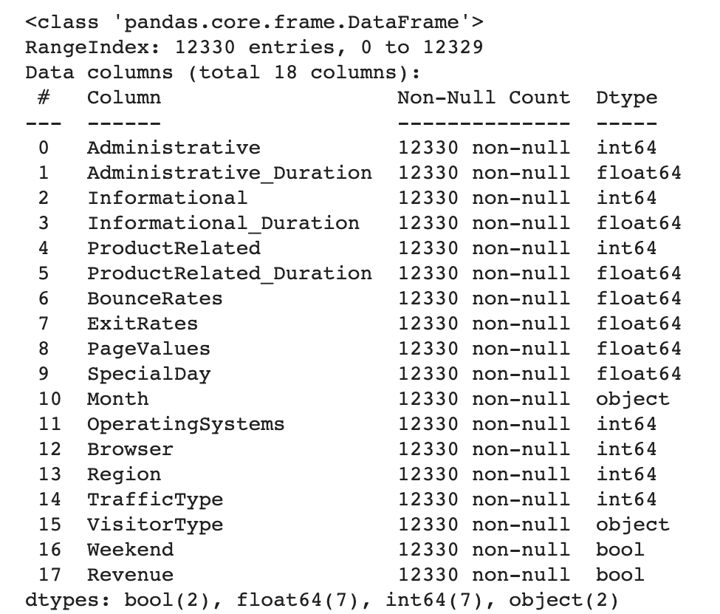
The dataset
The dataset consists of feature vectors belonging to 12,330 sessions, and for each one, whether or not it ended with shopping.
It represents data of different users visiting a website.
The dataset consists of 10 numerical and
8 categorical attributes.
The 'Revenue' attribute is a feature indicating if
the session ended with shopping or not.
https://archive.ics.uci.edu/ml/datasets/Online+Shoppers+Purchasing+Intention+Dataset

Slide 4
The context
The prediction of an online shopper intention can be useful to every company or merchant that owns a website.
Indeed, the study of specific attributes like the date, the browser or the time spent on a particular page can determine a buyer’s profile and preferences. It can also give clues about what a potential shopper likes or dislikes, in order to optimize the website and make more sales.

Slide 5
How can we predict whether a user will purchase ?

Slide 6
Our goal is to predict if a visitor is going to buy on the website according to his session’s data.
This is a classification problem.
In order to resolve this problem, we will first do some features engineering on the dataset.
Then, we will apply 3 differents models made for classification problems :
Decision Tree
Multi-Layer Perceptron
Random Forest Classifier
We will see which one is more effective on our dataset.

Slide 7
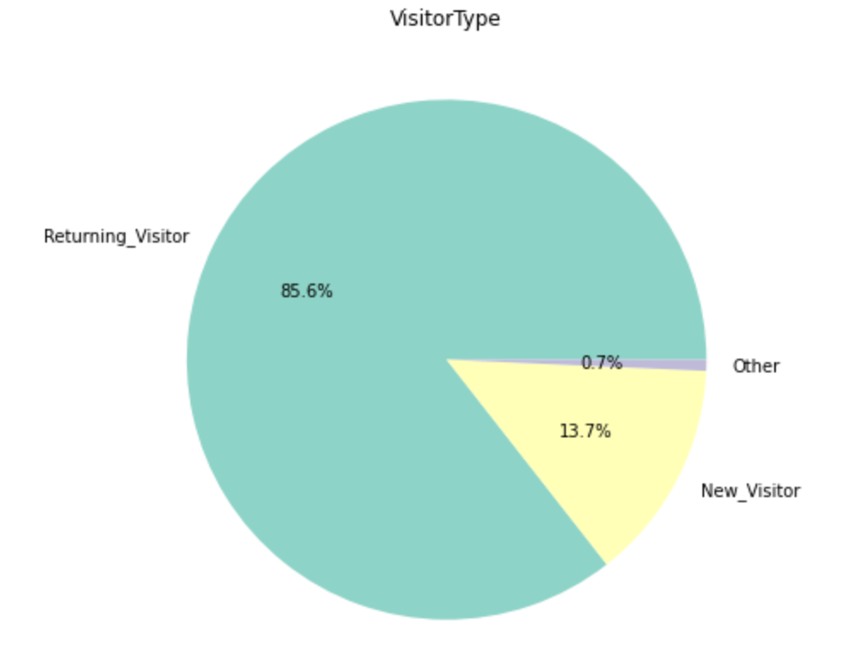
Visualization
Here are some diagrams made in order to evaluate our dataset.
We can see that the majority of visitors (85.6%) have already been on the website before.

Slide 8
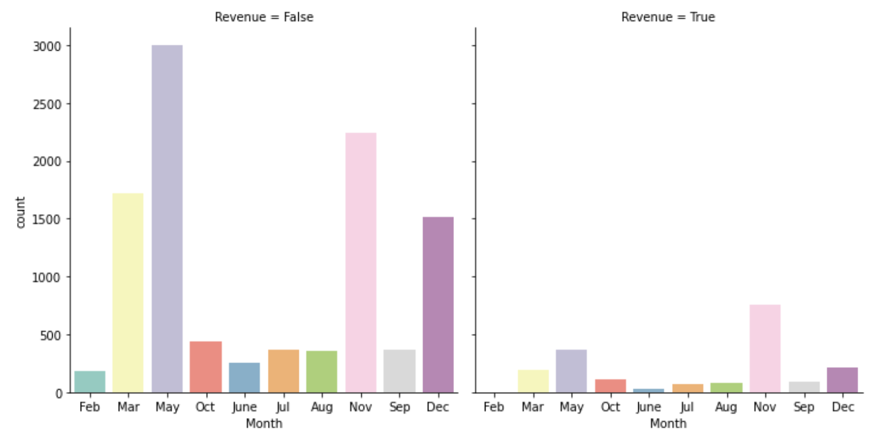
This visualization is very interesting because we can see that the number of visitor is the highest on May, however, the visitors that purchase are more numerous on November.

Slide 9
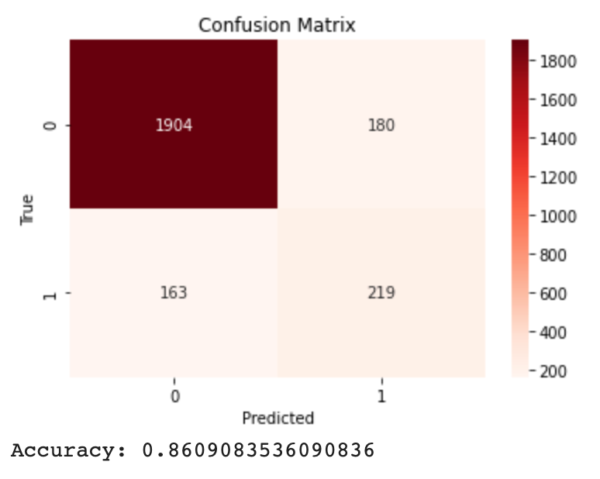
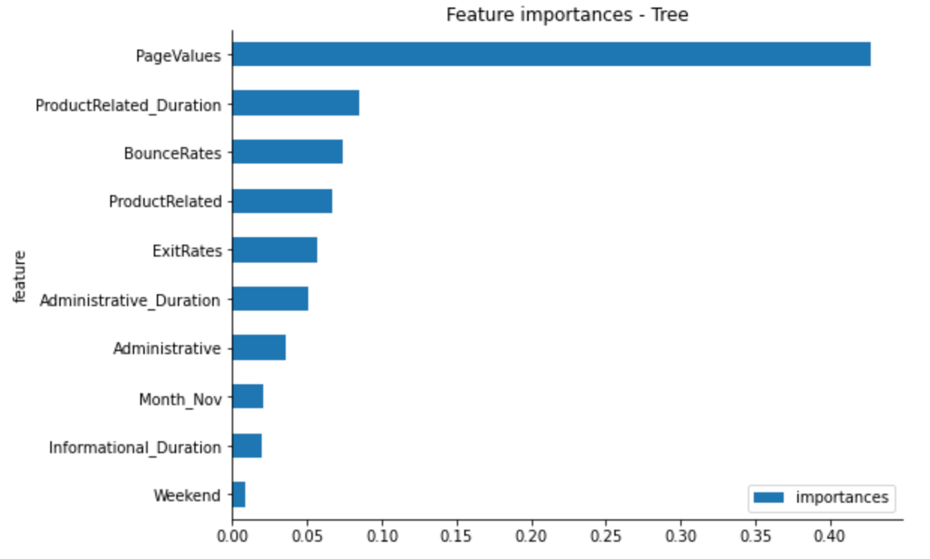
Classification Tree
For our first model, we'll use a Decision Tree as a classifier. Trees are simple models but they are really good for our problem. Indeed, the Tree is well suited for discrete variables since it is easy to make separation between discrete steps.
As the confusion matrix shows as well as the accuracy, the results are really good.

Slide 10
Multi-layer Perceptron
For our second model, we define a Multi-layer Perceptron.
Since it's a binary classification, we'll have a sigmoid in output and we'll compile our model with the binary_crossentropy loss. We use 10% of our data set as validation set to prevent over-fitting.
We adjust some parameters such as the number of neurons and the optimizer so that our loss and accuracy become stable.
However, even if our accuracy is very good (0.88), we notice that the Multi-layer Perceptron tends to predict the "class 0" to every observations. It does this because it will reduce the error since there is more "class 0" observations compared to the "class 1".
To counter this, we decide to assign weight to each class when fitting. With the parameter "class_weight", we'll tell the network that "class 0" will have a weight of 1 and "class 1" will have a weight of 2. With this, we'll penalize the network when it makes errors on "class 1".

Slide 11
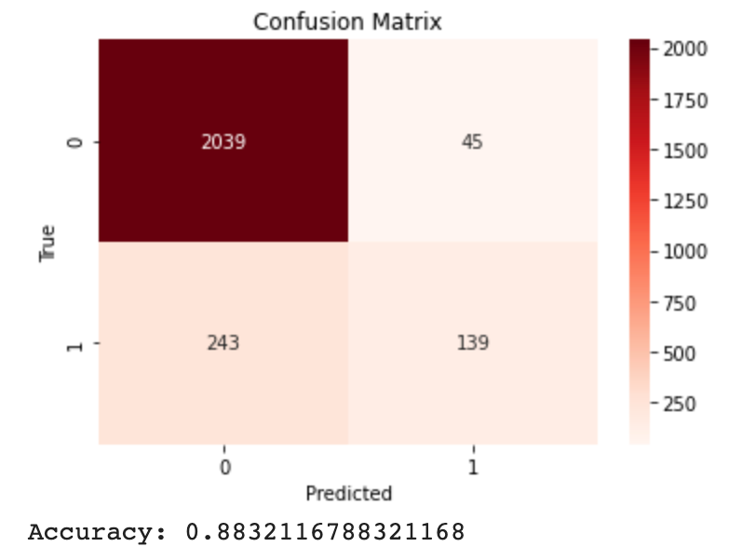
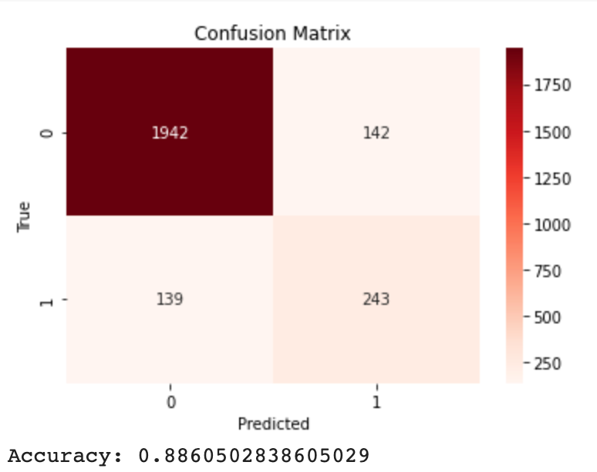
The accuracy has slightly decreased but the result is way better : when assigning class weights, we reduced the bias induced in the network so we have more "class 1" observation predicted which is more estimable compared to before.

Slide 12
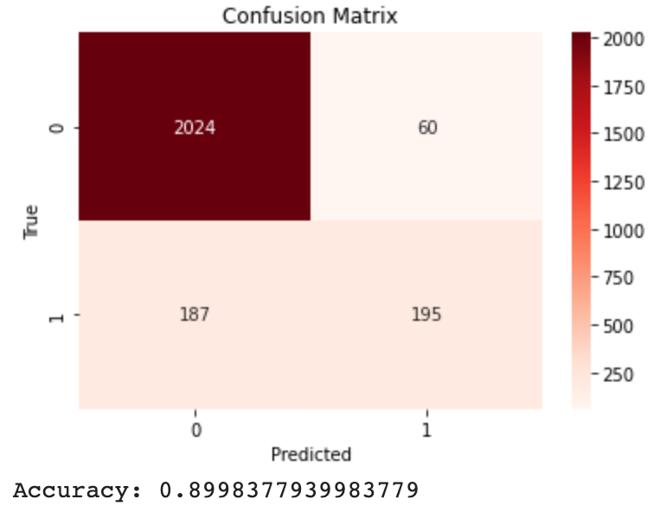
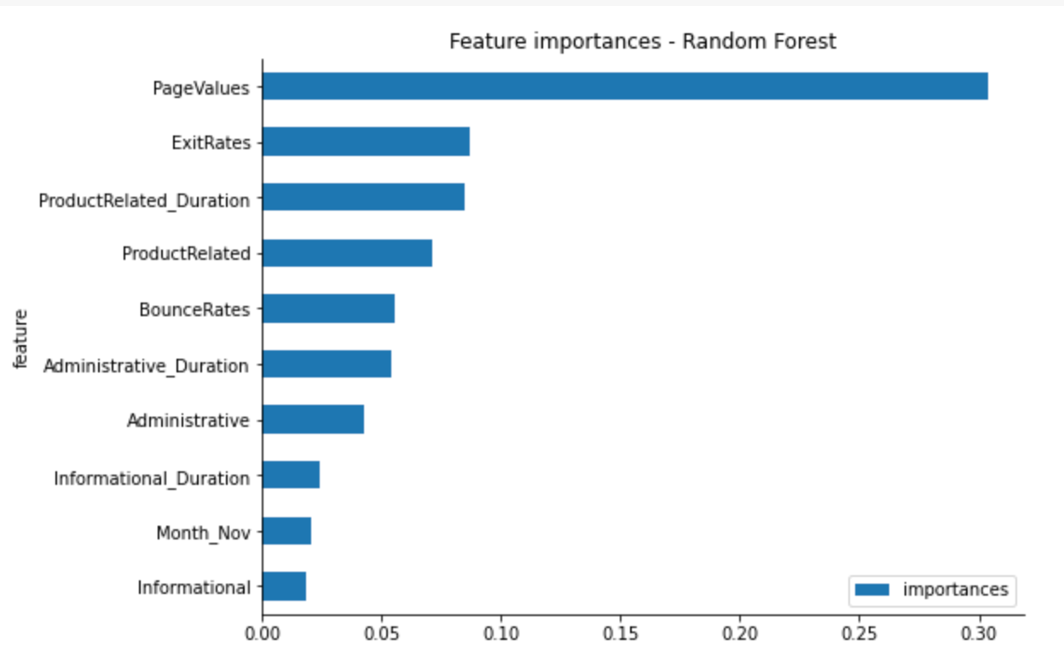
Random Forest
The Multi-layer Perceptron gave really good results but it's not very interpretable and, since we have a lot of categorical variables, a Tree based model will be better for our problem.
For our final model, we'll use a Random Forest Classifier. This model is derived from Decision Trees and it uses several to create a "forest". Random Forests are easy to interpret and show better results than the classic single Tree.
The results are really good but we apply a GridSearch to our Random Forest to determine the optimal parameters for our model.

Slide 13
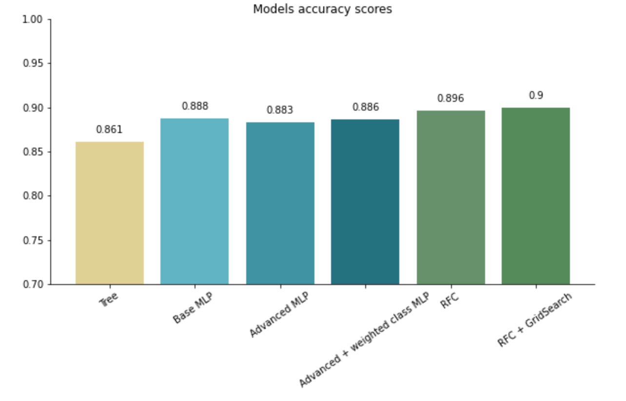
Results
The comparison of accuracies shows that the best model was the Random Forest with the parameters determined by the GridSearch with 0.9 !
The Multi-layer Percepton’s accuracy was very good too, but as we have a majority of non-buying visitors in our dataset, the model tend to predict this behaviour so we cannot say that it was the best fit.

